Slide 1

Introduction to Environmental Engineering ENVE 101 (2 Credit hrs)
Offered by:
Department of Environmental Science and Engineering
School of Science
Kathmandu University

Slide 2
Course Outline
Introduction to Environmental Engineering
Ecosystem, System Approach and Hydrology
Mass and Energy Transfer
Water and Wastewater (Part I and II)
Air and Noise pollution
Solid Waste Engineering
Environmental Management System

Slide 3
Environment…?

Slide 4
Trees, Forest? Atmosphere?? Soil?? Water?? Air?? Pollution?? Surrounding? Location?? Situation? Setting?? | Trash?? Noise?? River?? Site? Drainage?? Public Health?? Sanitation?? Hazards?? Plants? Animals??

Slide 5
Who is an Engineer…?
An engineer is a creative, ingenious person.
Makes engine…?
Problem solver…?
Designer…?
Ease maker…?

Slide 6
CHAPTER 1: INTRODUCTION

Slide 7

Engineering

Slide 8
Engineering is a profession that applies mathematics and science to utilize the properties of matter and sources of energy to create useful structures, machines, products, systems and processes (Davis and Cornwell, 2010).
Engineering may be defined as the application, under constraints of scientific principles, to the planning, design, construction, and operation of structures, equipment, and systems for the benefit of society ( Sincero and Sincero, 1996).
In other words, Engineering may be defined as the application, under constraints of scientific principles, to the planning, design, construction and operation of structures, equipment and systems for the benefit of the society.

Slide 9
Environmental Engineering
Application of engineering principles, under constraint, to the protection and enhancement of the quality of the environment and to the enhancement and protection of public health and welfare (Sincero and Sincero, 1996).
Environmental engineering is focused on:
Control of water, soil and atmospheric pollution and noise pollution.
To design, build and operate water and wastewater treatment plants.
To build and operate solid waste collection, transportation and disposal systems
To carry out environmental assessment of projects and products
To provide inputs in decision making regarding the environmental issues of development sector and welfare of public

Slide 10
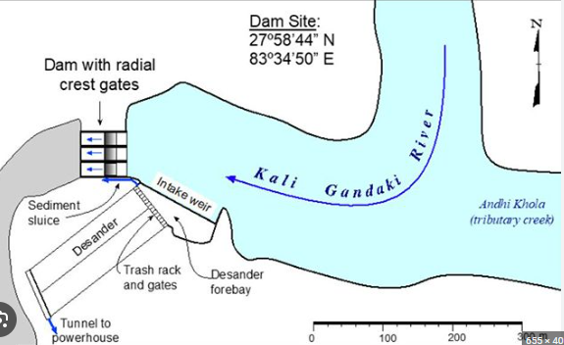
Engineering Project
Pic: International Hydropower Association

Slide 11
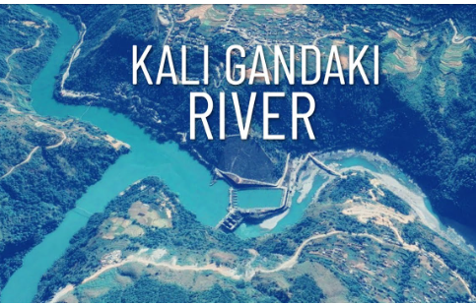
Engineering Project
Kali Gandaki A Hydropower Project has capacity of 144 MW (3 turbines)

Slide 12
CLASS ROOM TASK
List the name of two Projects recently completed in your Province.
SN | Name of Project | Size Capacity

Slide 13
Engineering Project
Any engineering project,
large or small,
a product being designed,
or a service to be provided encompasses within its implementation.
a series of decisions made by engineers. Sometimes these decisions turn out to be poor and or not appropriate.

Slide 14
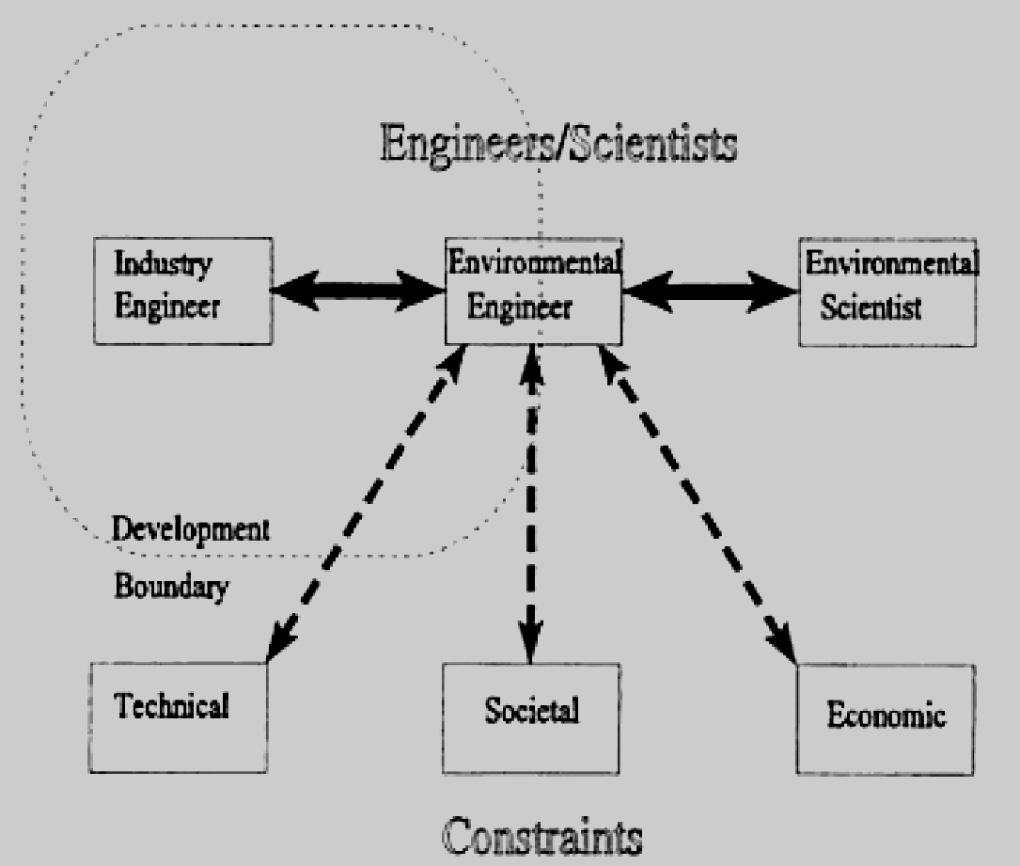
Engineering Decision
For any projects to be done:
Technically Feasible
Economically Viable
Environmental Friendly
Socially Acceptable
consideration a multiple of factors when making decisions.

Slide 15
Technical (feasibility) Analysis
Technical decisions are quantifiable.
It can be evaluated and checked by other competent professional engineers.
We do not have all the information we need to make decisions.
Therefore, we must make assumptions. These assumptions, of course, must be made using the best available data with a (sometimes liberal) sprinkling of good judgment.

Slide 16
Problem
A town with 4000 residents wants to establish a municipally owned and operated
solid waste (garbage) collection program. They can purchase one of three possible
trucks that have the following capacity:
Truck A: 8 m³
Truck B: 6 m³
Truck C: 4 m³
If the truck is to collect the refuse everyday, and the truck will have to make only one trip per day to the landfill. Which truck or trucks will have sufficient capacity?
Make Logical assumptions as per need.

Slide 17
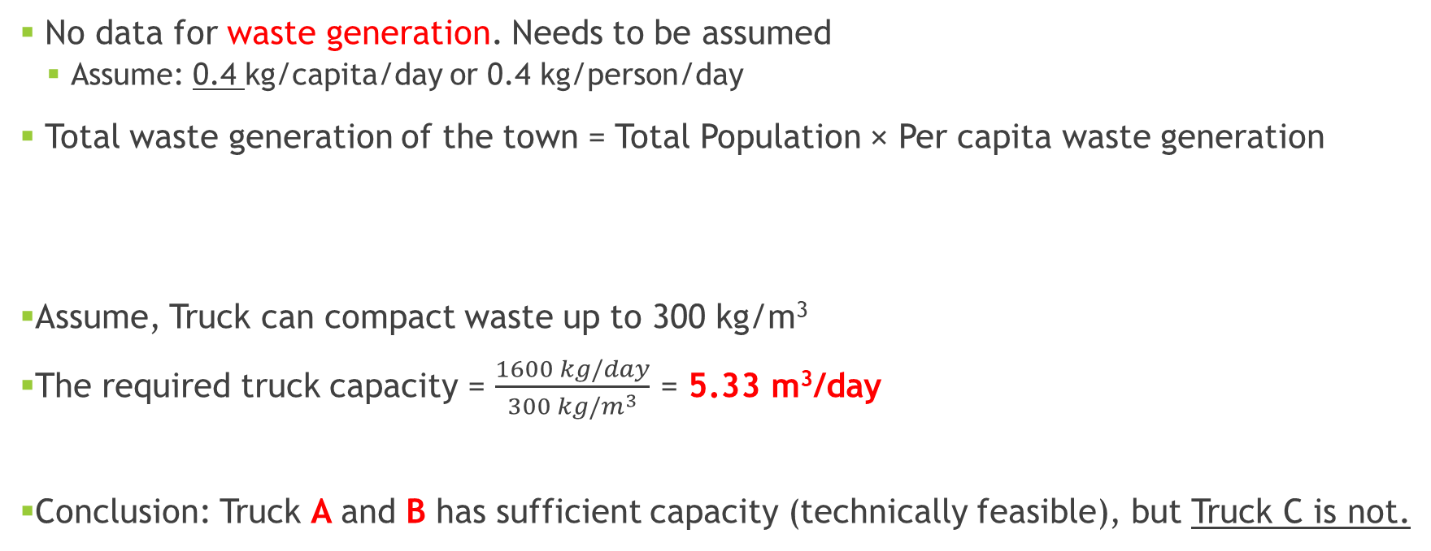

Solution
Truck A: 8 m³
Truck B: 6 m³
Truck C: 4 m³

Slide 18
2. Cost Effectiveness
An engineering problem be analyzed on the basis of the cost.
If a municipal engineer is considering purchasing refuse collection vehicles and finds that the following alternatives to buy the Truck
Expensive trucks: Higher compaction, reduces volume, reduces no. of trips per day
Inexpensive trucks: lower compaction, requires more trips per day
How does the engineer know which is less expensive for the community?

Slide 19
Internal Rate of Return (IRR)
An indicator to reflect the profit of the projects.
Internal rates of return are commonly used to evaluate the desirability of investments or projects.
The higher a project's internal rate of return, the more desirable it is to undertake the project.
Assuming all projects require the same amount of up-front investment, the project with the highest IRR would be considered the best and undertaken first.

Slide 20
IRR values of the projects in Nepal
SN | Project Name | Capacity | Project Cost (Arab) | IRR (%)
1 | Melamchi Water Supply Project | 170 MLD | 32.48 | 13.50
2 | Kaligandaki A Hydroelectric Project | 144 MW | 31.70 | 15.00
3 | Raxual- Kathmandu Railway (Estimated) | 135 km | 264 | 5.65
4 | Upper Trishuli-3’B’ Hydroelectric Project | 37 MW | 4.31 | 23.60
5 | Butwal to Mahendranagar Transmission-II | 132 kV | 2.72 | 14.71

Slide 21
3. Environmental Analysis
When engineers work on projects, they need to assess the potential impact on the environment.
This involves considering factors such as air and water pollution, greenhouse gas emissions, habitat destruction, and resource depletion.
By conducting environmental assessments, engineers can identify and implement solutions that minimize adverse environmental impacts.

Slide 22
4. socially acceptable decisions
Engineers must also consider the social implications of their projects.
This includes assessing the project's impact on local communities, public health, cultural heritage, and overall quality of life.
Social analysis may involve engaging with stakeholders, understanding their needs and concerns, and incorporating their input into the engineering process.

Slide 23
Environmental Laws and Regulation
Environment Protection Act (EPA), 2076 and Environmental Protection Rules (EPR), 2077
Solid Waste Management Act, 2068
Water Resources Act, 2049
Different policies, standards, guidelines like guidelines and standards for air pollutants, vehicular emissions, water and wastewater quality, climate change policy

Slide 24
Three levels of environmental study in Nepal as per project size.
Brief Environmental Study (BES) is performed as guided by schedule 1 of EPR. Few examples of the projects requiring BES are
Hospitals from 16 beds up to 25 beds.
Hotels or Resort from 25 beds to 50 beds
Bridges up to 250 m.
Municipal or urban roads.
Up to 5 MLD water supply projects with treatment plant and sewer.

Slide 25
Three levels of environmental study in Nepal as per project size.
Initial Environmental Examination (IEE) is performed as guided by schedule 1 of EPR. Few examples of the projects requiring IEE are
Hospital from 25 to 100 beds, Hotel and resort of 51 to 100 beds.
Bridge above 250 m.
New road construction of up to 25 km.
Upgrading roads from 10 km to 50 km.
Acquisition of forest area from 1 ha to 5 ha.
Solar power plant upto 5 MW/ Hydropower upto 50 MW.

Slide 26
Three levels of environmental study in Nepal as per project size.
Environmental Impacts Assessment (EIA) is performed as guided by schedule 1 of EPR. Few examples of the projects requiring EIA are
Hospital and hotels above 100 beds.
Any projects acquiring National parks or conservation areas or forests above 5 ha.
Hydropower production above 50 MW.

Slide 27

Institution related to engineers in Nepal
Nepal Engineering Council Act, 2055 promulgated by then His Majesty the King on B.S.2055/11/27.
Nepal Engineering Council Rules, 2057 has also been prepared and approved
The first Executive Council was formed on Magh 2056.
The act was amended twice in 2076 and 2079 B.S.

Slide 28
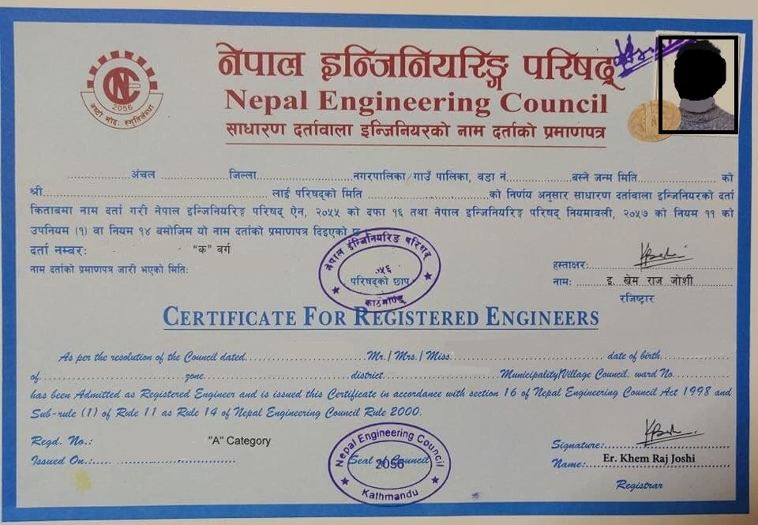
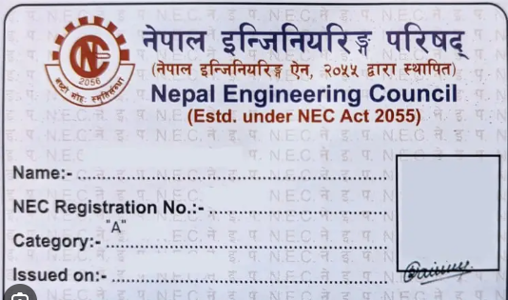
scope of the NEC
Licensing on the basis of exam
Registration of Engineer
Authorization of Certificates
Recognition of academic institutions
Produce and monitor the professional code of conduct.

Slide 29

Nepal Engineers Association (NEA)
To promote development of engineering, science and technology in Nepal.
To promote fellowship, goodwill and cooperation assistance among the Nepalese engineers and safeguard their rights and interests.
To continuously enhance the highest professional ideals among the members and widen it.

Slide 30

Society of Environmental Engineers Nepal (SEEN)
An institution established by Environmental Engineers of Nepal.
It works for the welfare or Environmental Engineering professionals of Nepal
SEEN is governed by an executive committee of seven (7) members elected by the general members of the society.

Slide 31
Enhancement of technical and professional competencies of its members.
It works for the protection of the basic professional rights
To support the government and other agencies in the formulation of policies and strategies in related fields.
To carry out various professional activities that are intended to bring qualitative results to improve the sanitary and environmental conditions of the country.

Slide 32

Society of Public Health Engineers, Nepal (SOPHEN)
Registered in Nepal in 1990 AD (2047 BS) as an independent professional organization by a group of Nepalese Engineers.

Slide 33
Nepal Environment Society (NES)
An institution that includes all the Environmental professionals of Nepal.

Slide 34
THANKYOU

